Slide 1
Connecting Vulnerable Seniors to Nutrition Assistance Strategies to Achieve Alignment, Collaboration, and Synergy Across Delivery and Financing Systems Research-In-Progress Webinar October 14, 2020 12-1pm ET

Slide 2
Agenda
Welcome: Carrington Lott, MPH
Program Manager for Systems for Action
Presenters:
Q&A: Carrington Lott, MPH
Jamila McLean, MPH and Suzanne Kinsky, MPH, PhD
Benefits Data Trust and UPMC Center for High Value Health Care
Joan Eichner, DrPH
UPMC Center for Social Impact

Slide 3
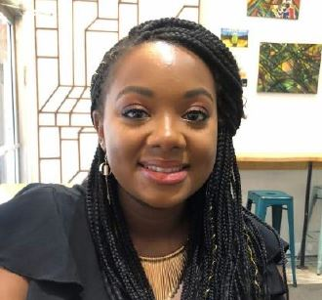
Presenters
Jamila McLean, MPH is the Healthcare Policy Manager at Benefits Data Trust. In this role, she analyzes and promotes policy and practice innovations that streamline access to Medicaid and other healthcare-related benefits – providing technical assistance to state agencies and their partners. Prior to joining BDT, McLean was a Program Officer at the Center for Health Care Strategies, where she supported efforts related to delivery system reform and children’s health. McLean holds a Master of Public Health, with a dual concentration in health systems and policy and health education and behavioral science, from the Rutgers School of Public Health.
Jamila McLean, MPH
Notes:
Sara—to add script here?

Slide 4
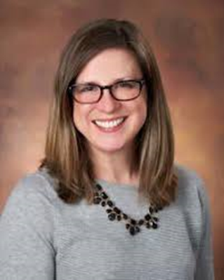
Presenters
Suzanne Kinsky, MPH, PhD is the Director of Research Translation and Capacity Building at UPMC’s Center for High-Value Healthcare, has nearly 20 years of experience implementing and evaluating both community- and clinically based health care initiatives. Her research interests include program evaluation and structural interventions to increase access to healthcare and improve health outcomes for vulnerable populations. In her current role, Dr. Kinsky conducts health services research to improve health care outcomes among UPMC members, including those enrolled in the CHC program. She also leads the dissemination of research and evaluation results by writing manuscripts for publication.
Suzanne Kinsky, MPH, PhD

Slide 5
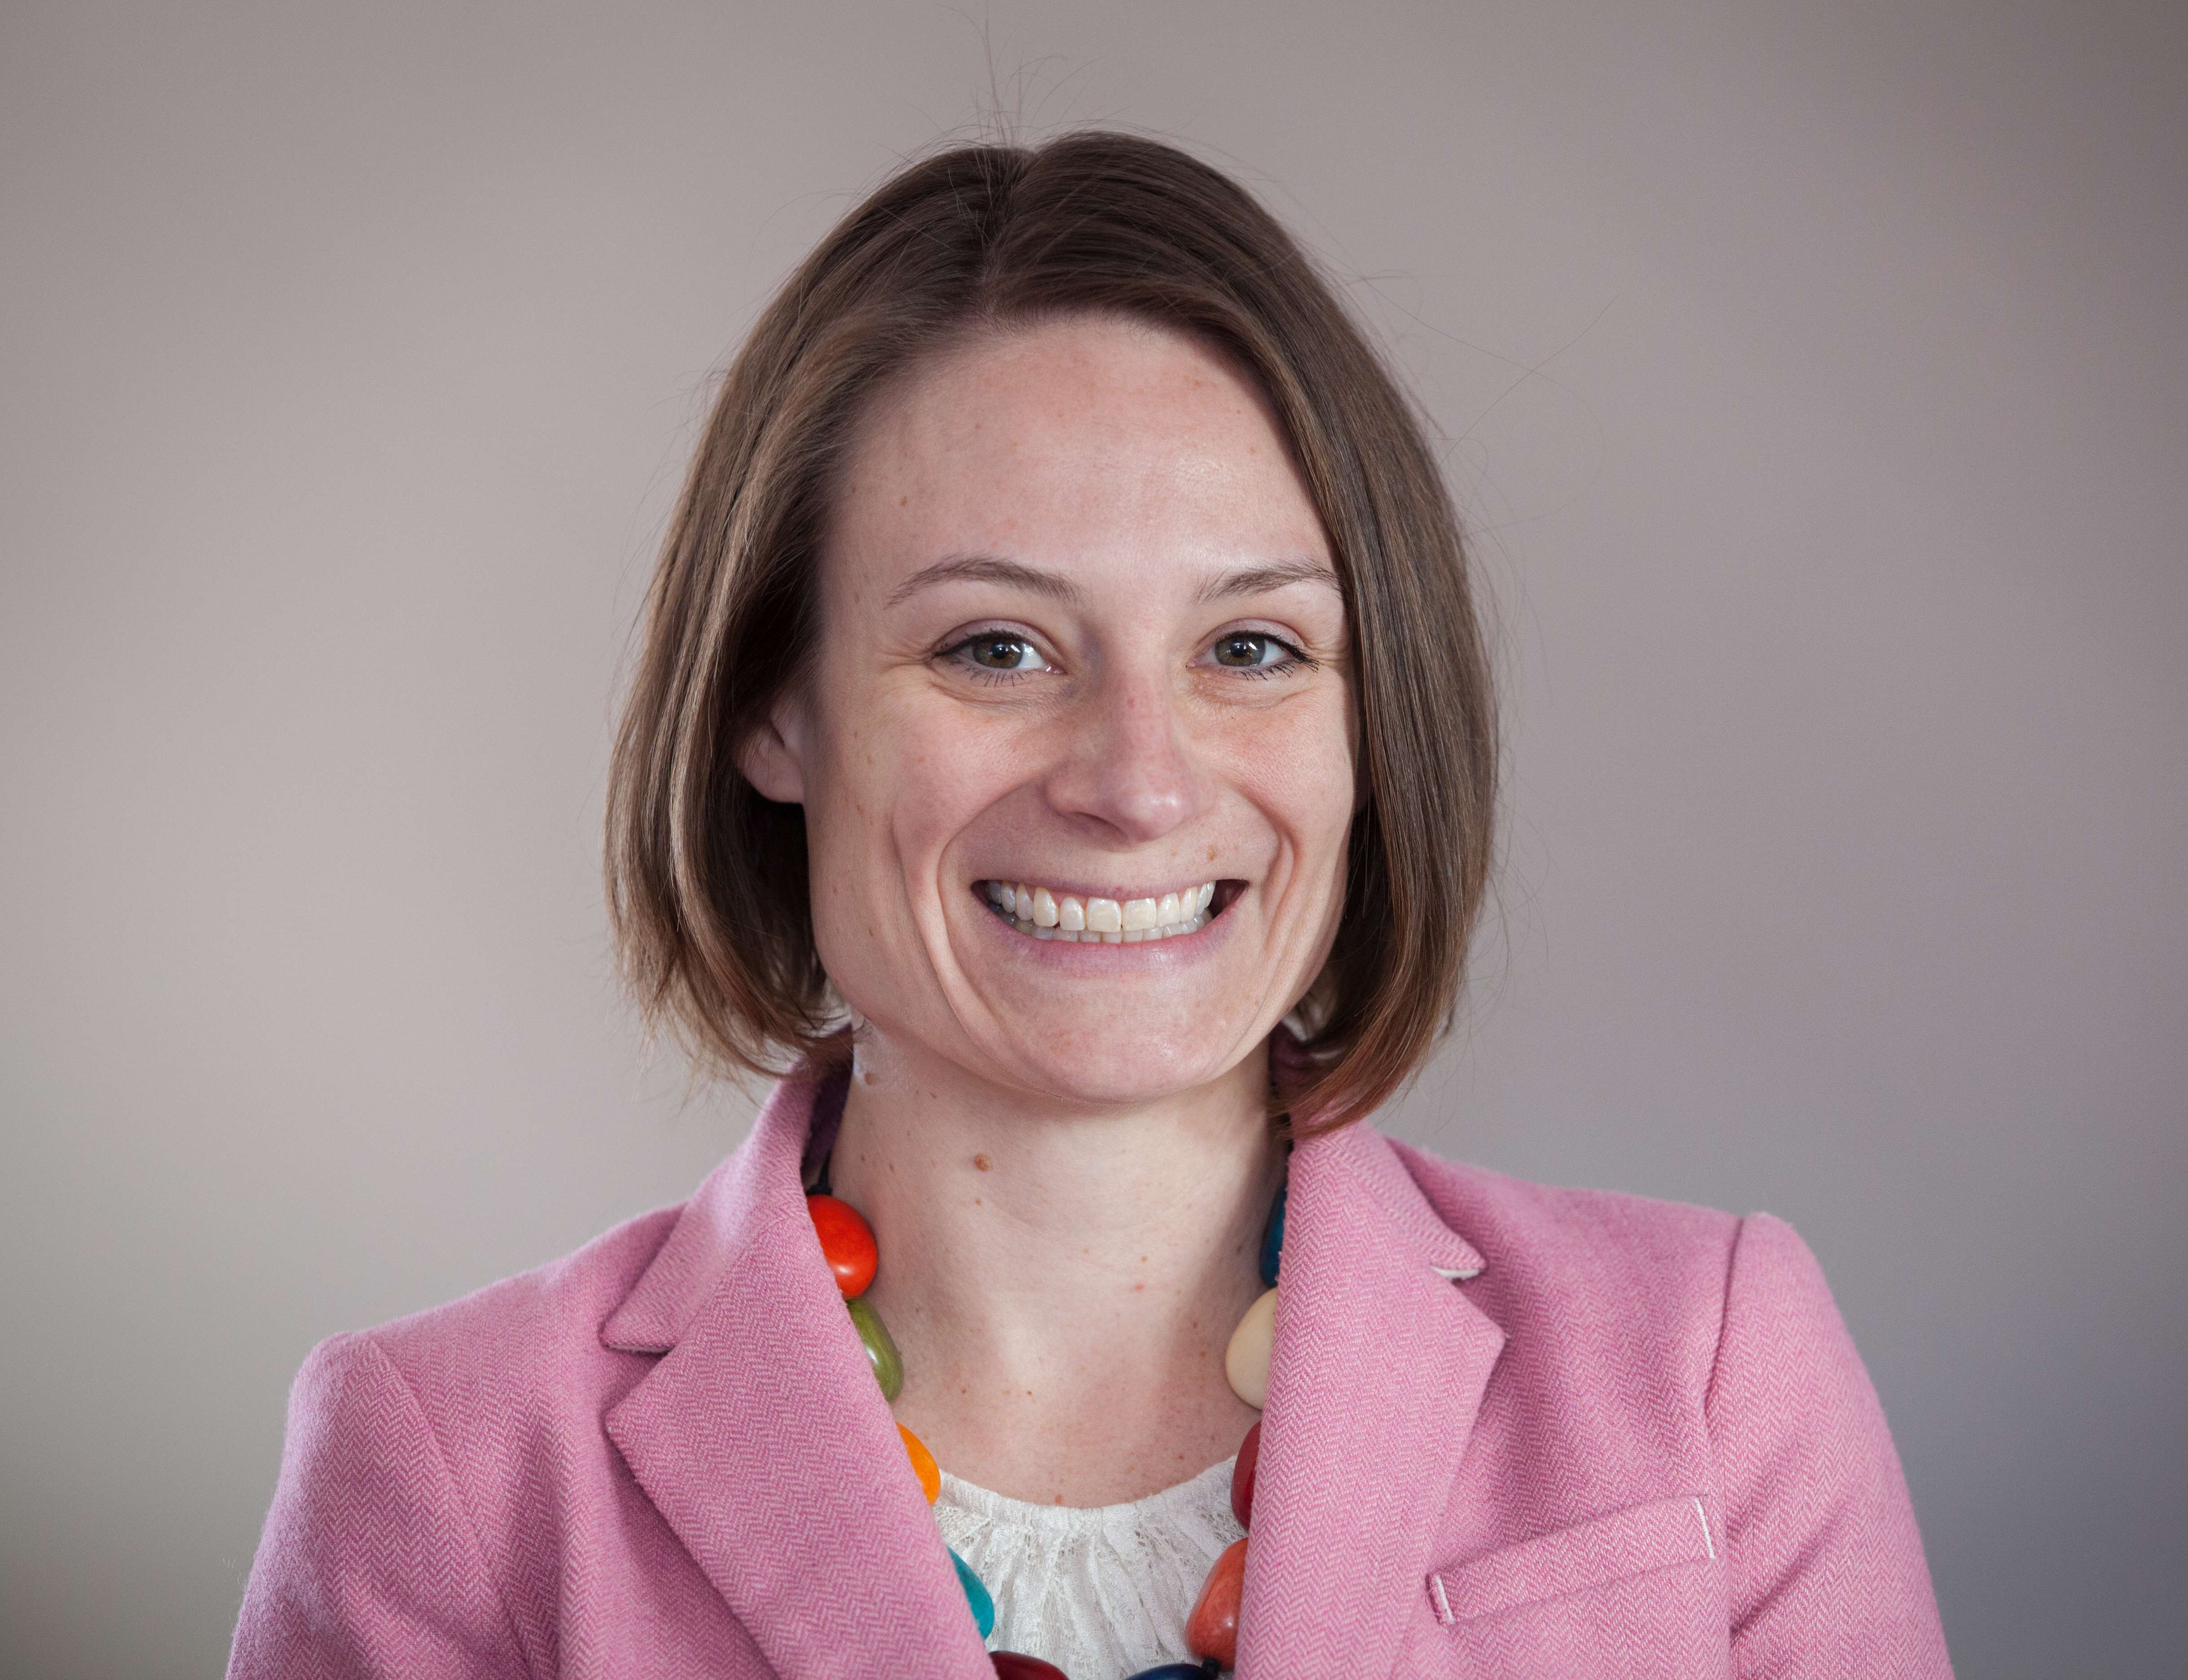
Commentator
Joan Eichner, DrPH joined the UPMC Health Plan in 2017 as a Program Administrator with the Center for High-Value Health Care. In that role, she collaborated to design and implement internally- and externally-funded research and evaluation projects to improve health care quality, efficiency, patient experience, and patient outcomes. In 2020 Dr. Eichner transitioned to the new UPMC Center for Social Impact as the Director of Operations and Evaluation. As a social intervention evaluator, Joan works with a multidisciplinary team to design and evaluate health system- and payer-driven actions that identify and address member- and community-level health related social needs.
Prior to UPMC, Joan worked at the University of Pittsburgh Office of Child Development as the Director of the Division of Applied Research and Evaluation and was a Peace Corps Volunteer in Guyana, South America.
Joan holds a doctorate in public health with a focus on behavioral and community health sciences from the University of Pittsburgh and masters degrees in public health and public administration. Outside of work, Joan serves as Board President of HEARTH, a transitional housing program for women and children who are survivors of domestic violence, and sits on the Board of the Pittsburgh Child Guidance Foundation.
Joan Eichner, DrPH

Slide 6
Agenda
Overview of UPMC Community Health Choices and Benefits Data Trust
Our Research Design
Impact of COVID-19 on our study
Implications for this work
Q&A

Slide 7
Overview of UPMC Community Health Choices and Benefits Data Trust

Slide 8
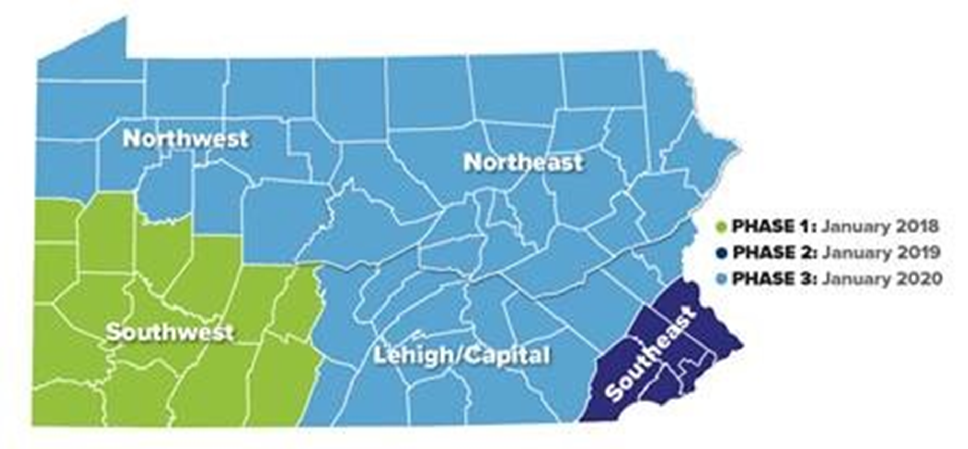
CHC Zones

Slide 9
Membership Breakdown as of September 2020

Slide 10
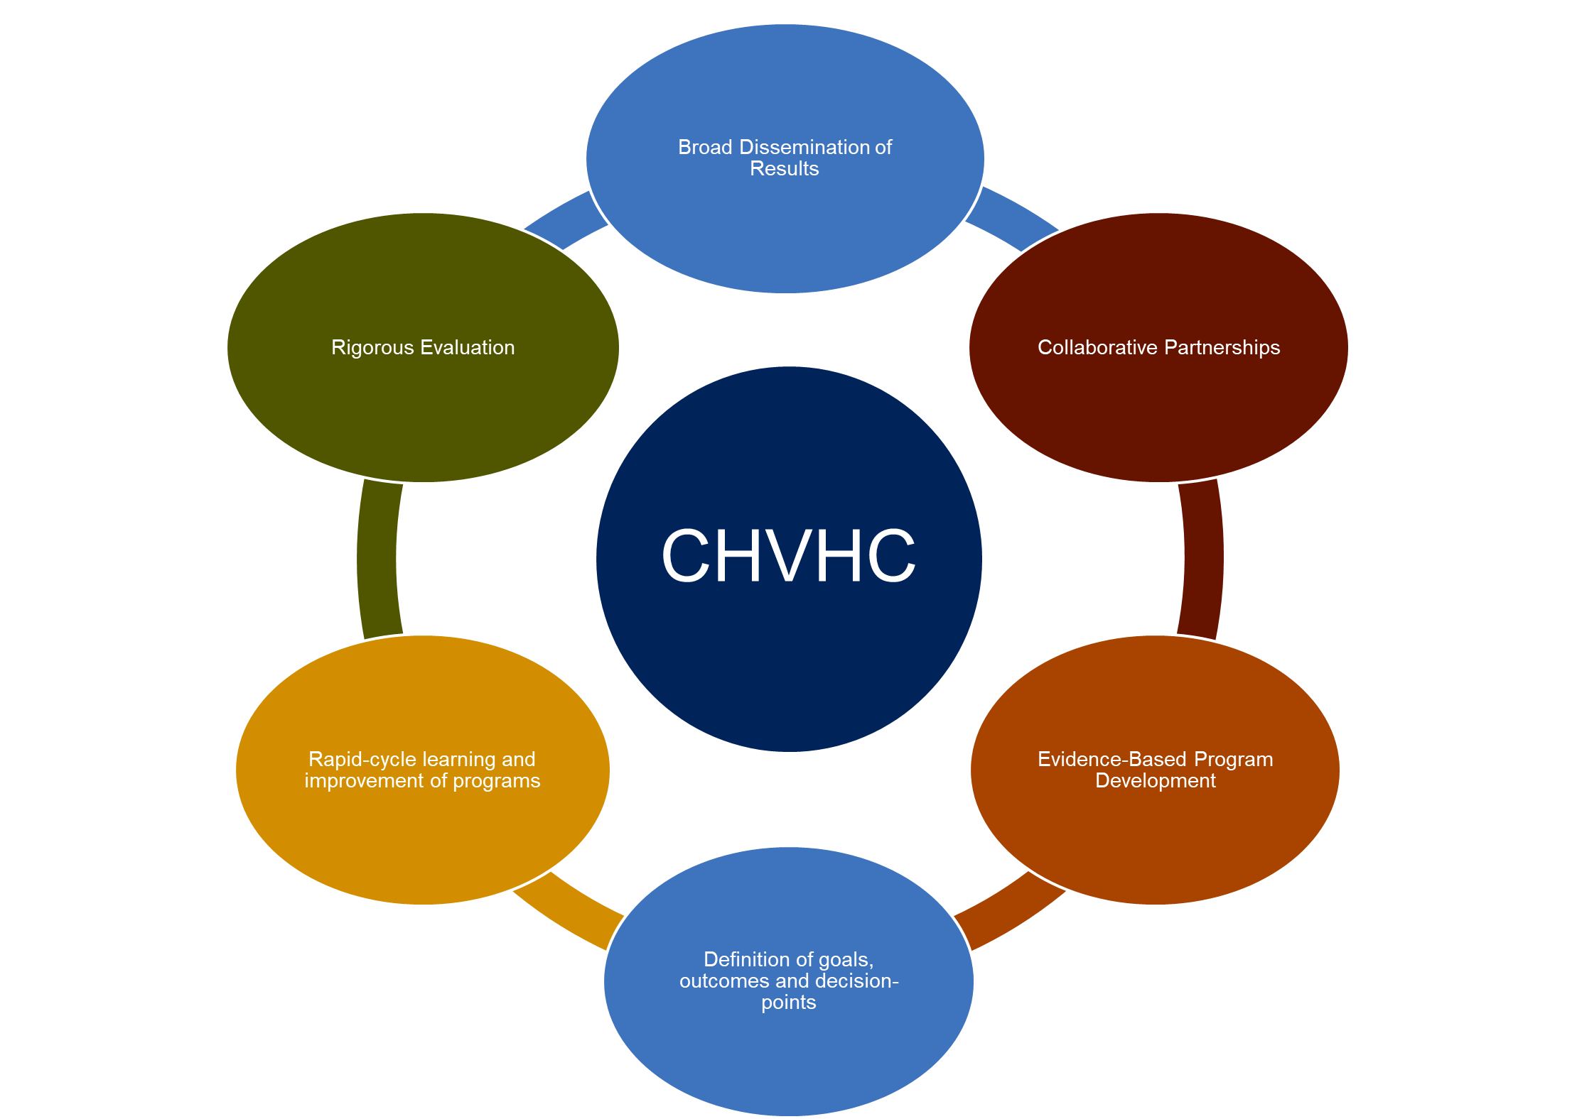
UPMC Center for High-Value Health Care
Established in 2011 as a nonprofit research organization, owned by UPMC, housed within the UPMC ISD
Goals:
Enhance visibility and promote innovation through externally-funded research that supports/ leverages ongoing work across the ISD
Support innovation and growth through a collaborative rapid cycle evaluation and learning process
Broadly disseminate findings through an active agenda of publication and presentations to spotlight UPMC’s unique IDFS value proposition

Slide 11
Benefits Data Trust: What we do
Benefits Data Trust (BDT) helps people live healthier, more independent lives
by breaking down barriers to public benefits access.

Slide 12
Partnering with healthcare to address social needs
In 2018, BDT and UPMC formalized a partnership to:
Identify UPMC’s CHC members who were eligible for but not receiving SNAP (the Supplemental Nutrition Assistance Program) by matching UPMC member lists with state lists;
Conduct targeted outreach to these members via mail, directing them to BDT’s contact center; and
Provide comprehensive application assistance to members, including document assistance, follow up, and completion of the application on behalf of the eligible UPMC member.

Slide 13
Helping people access public benefits is proven to improve health and reduce costs

Slide 14
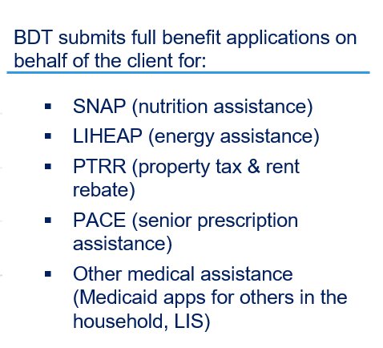
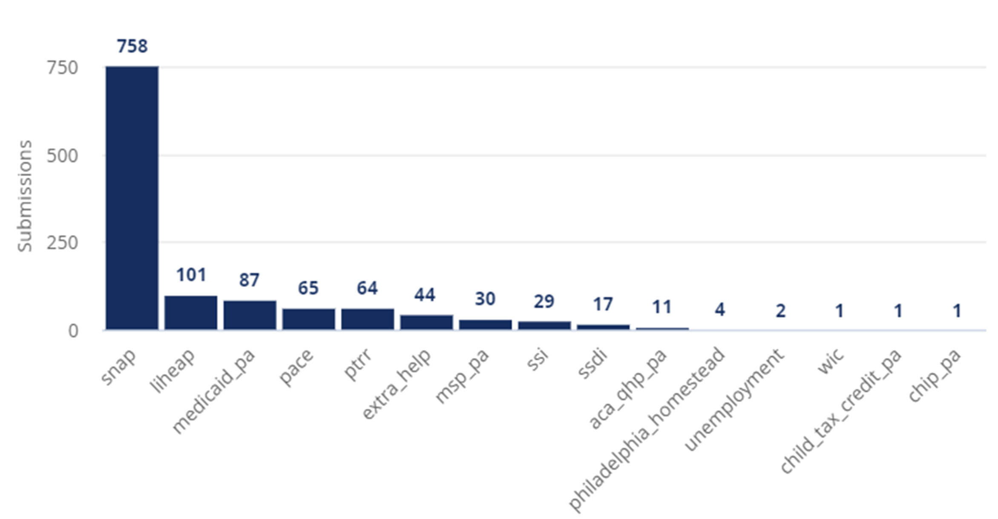
Intervention impact thus far
BDT helps with referrals for all other benefits listed such as SSI (Supplemental Security Income), WIC(nutrition assistance for women, infants and children), Unemployment Compensation, etc.

Slide 15
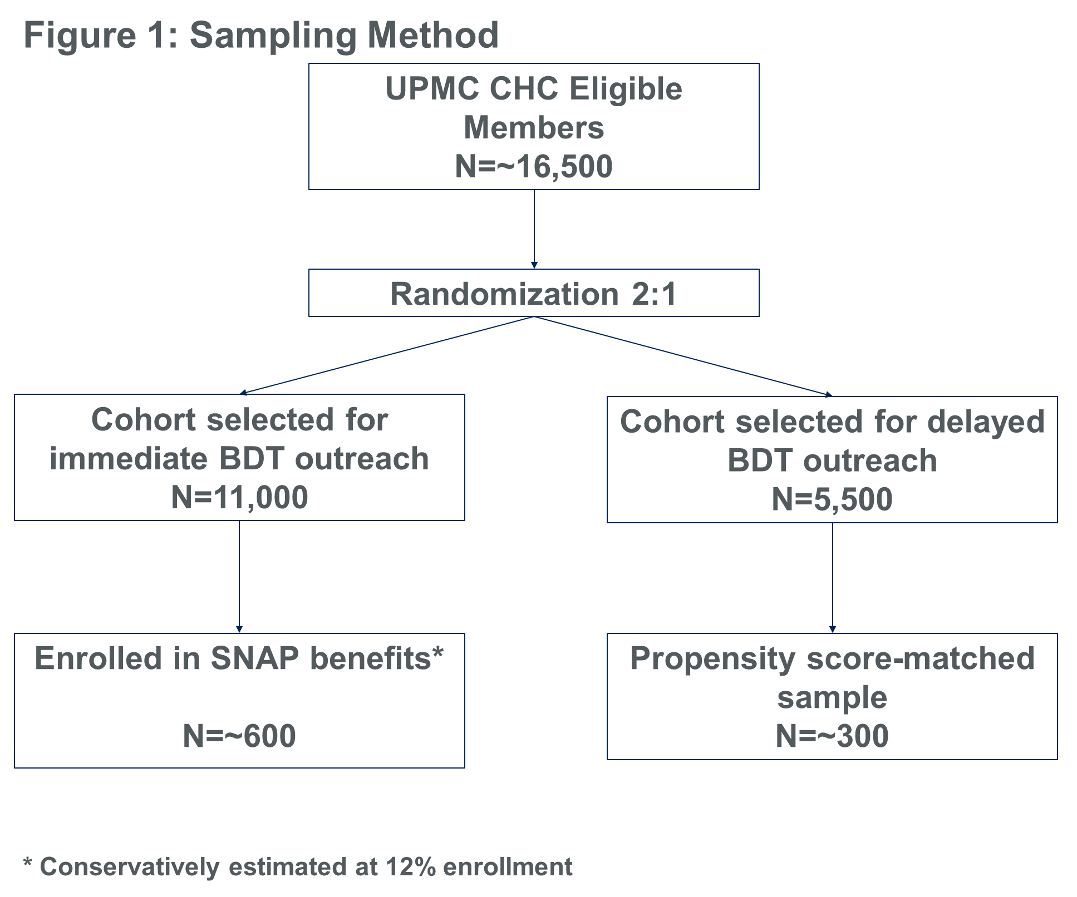
Research Design
Quasi-experimental wait list design
Capitalizing on workload realities
Cohorts randomly selected for immediate vs. delayed outreach
Primary independent variable: SNAP enrollment
Primary dependent variable: Hospital utilization

Slide 16
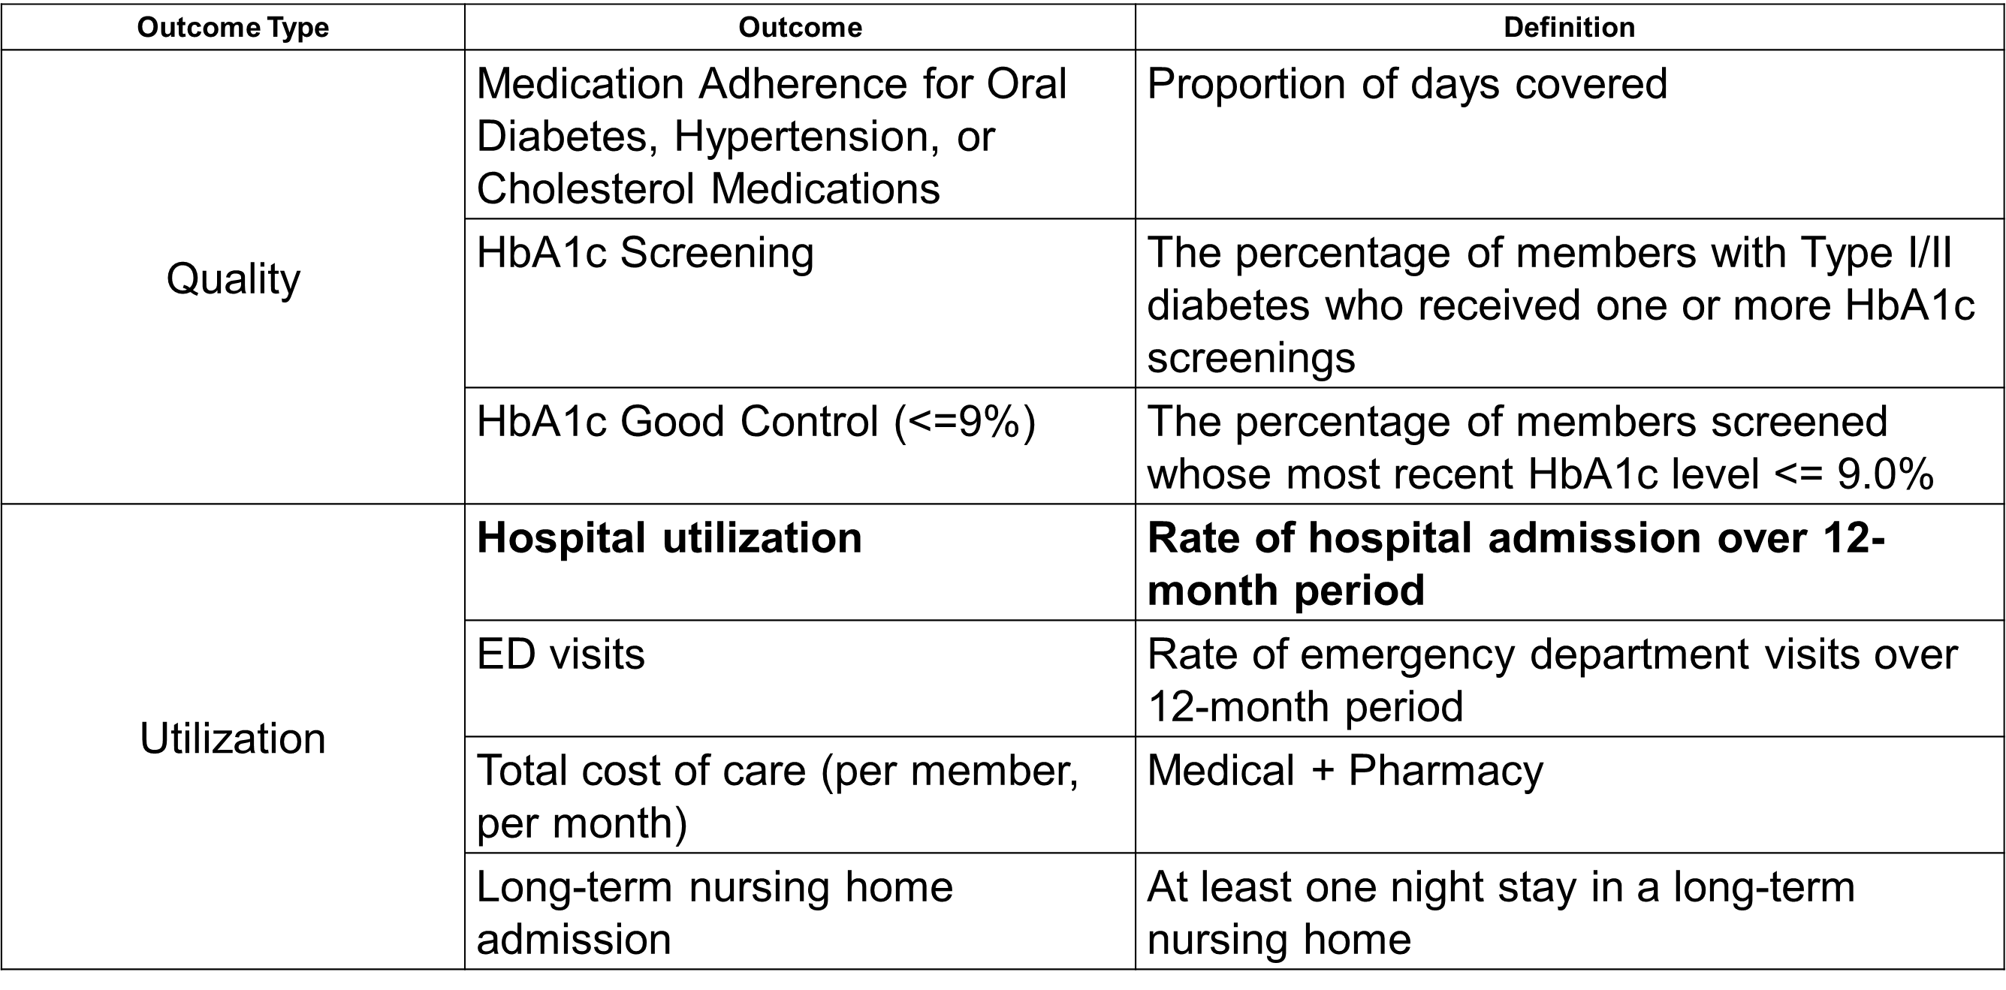
Outcomes
Primary independent variable: SNAP enrollment

Slide 17
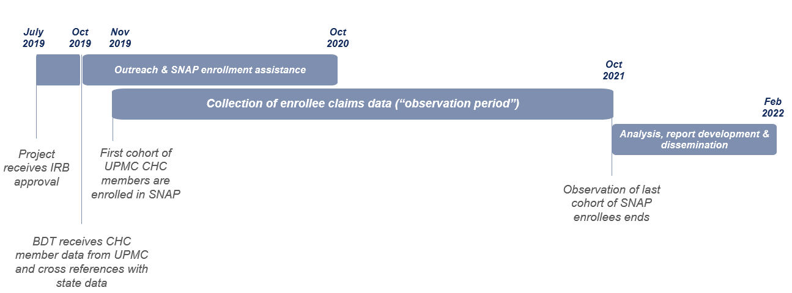
Project Timeline - Revised

Slide 18
Impact of COVID-19 on our study

Slide 19
Policy Changes Impacting Food Security During COVID-19

Slide 20
COVID Impact on Study

Slide 21
Implications

Slide 22
Commentary
Joan Eichner, DrPH
UPMC Center for Social Impact

Slide 23
Questions?
www.systemsforaction.org
@Systems4Action

Slide 24
Certificate of Completion
If you would like to receive a certificate of completion
for today’s ResProg webinar, please
complete the survey at the end of the session.
One will be emailed to you.

Slide 25
Upcoming Webinars
October 28th | 12pm ET
0 Closing the Gaps in Health and Social Services for Low-Income Pregnant Women0
Irene Vidyanti, PhD and William Nicholas, PhD | Los Angeles County Department of Public Health
November 11th | 12pm ET
0 Can Subsidized Transportation Options Slow Diabetes Progression?
Fei Li, PhD and Christopher Kajetan Wyczalkowski, PhD | Georgia State University

Slide 26
Acknowledgements
Systems for Action is a National Program Office of the Robert Wood Johnson Foundation and a collaborative effort of the Colorado School of Public Health, administered by the University
of Colorado Anschutz Medical Campus, Aurora, CO.

